Slide 1
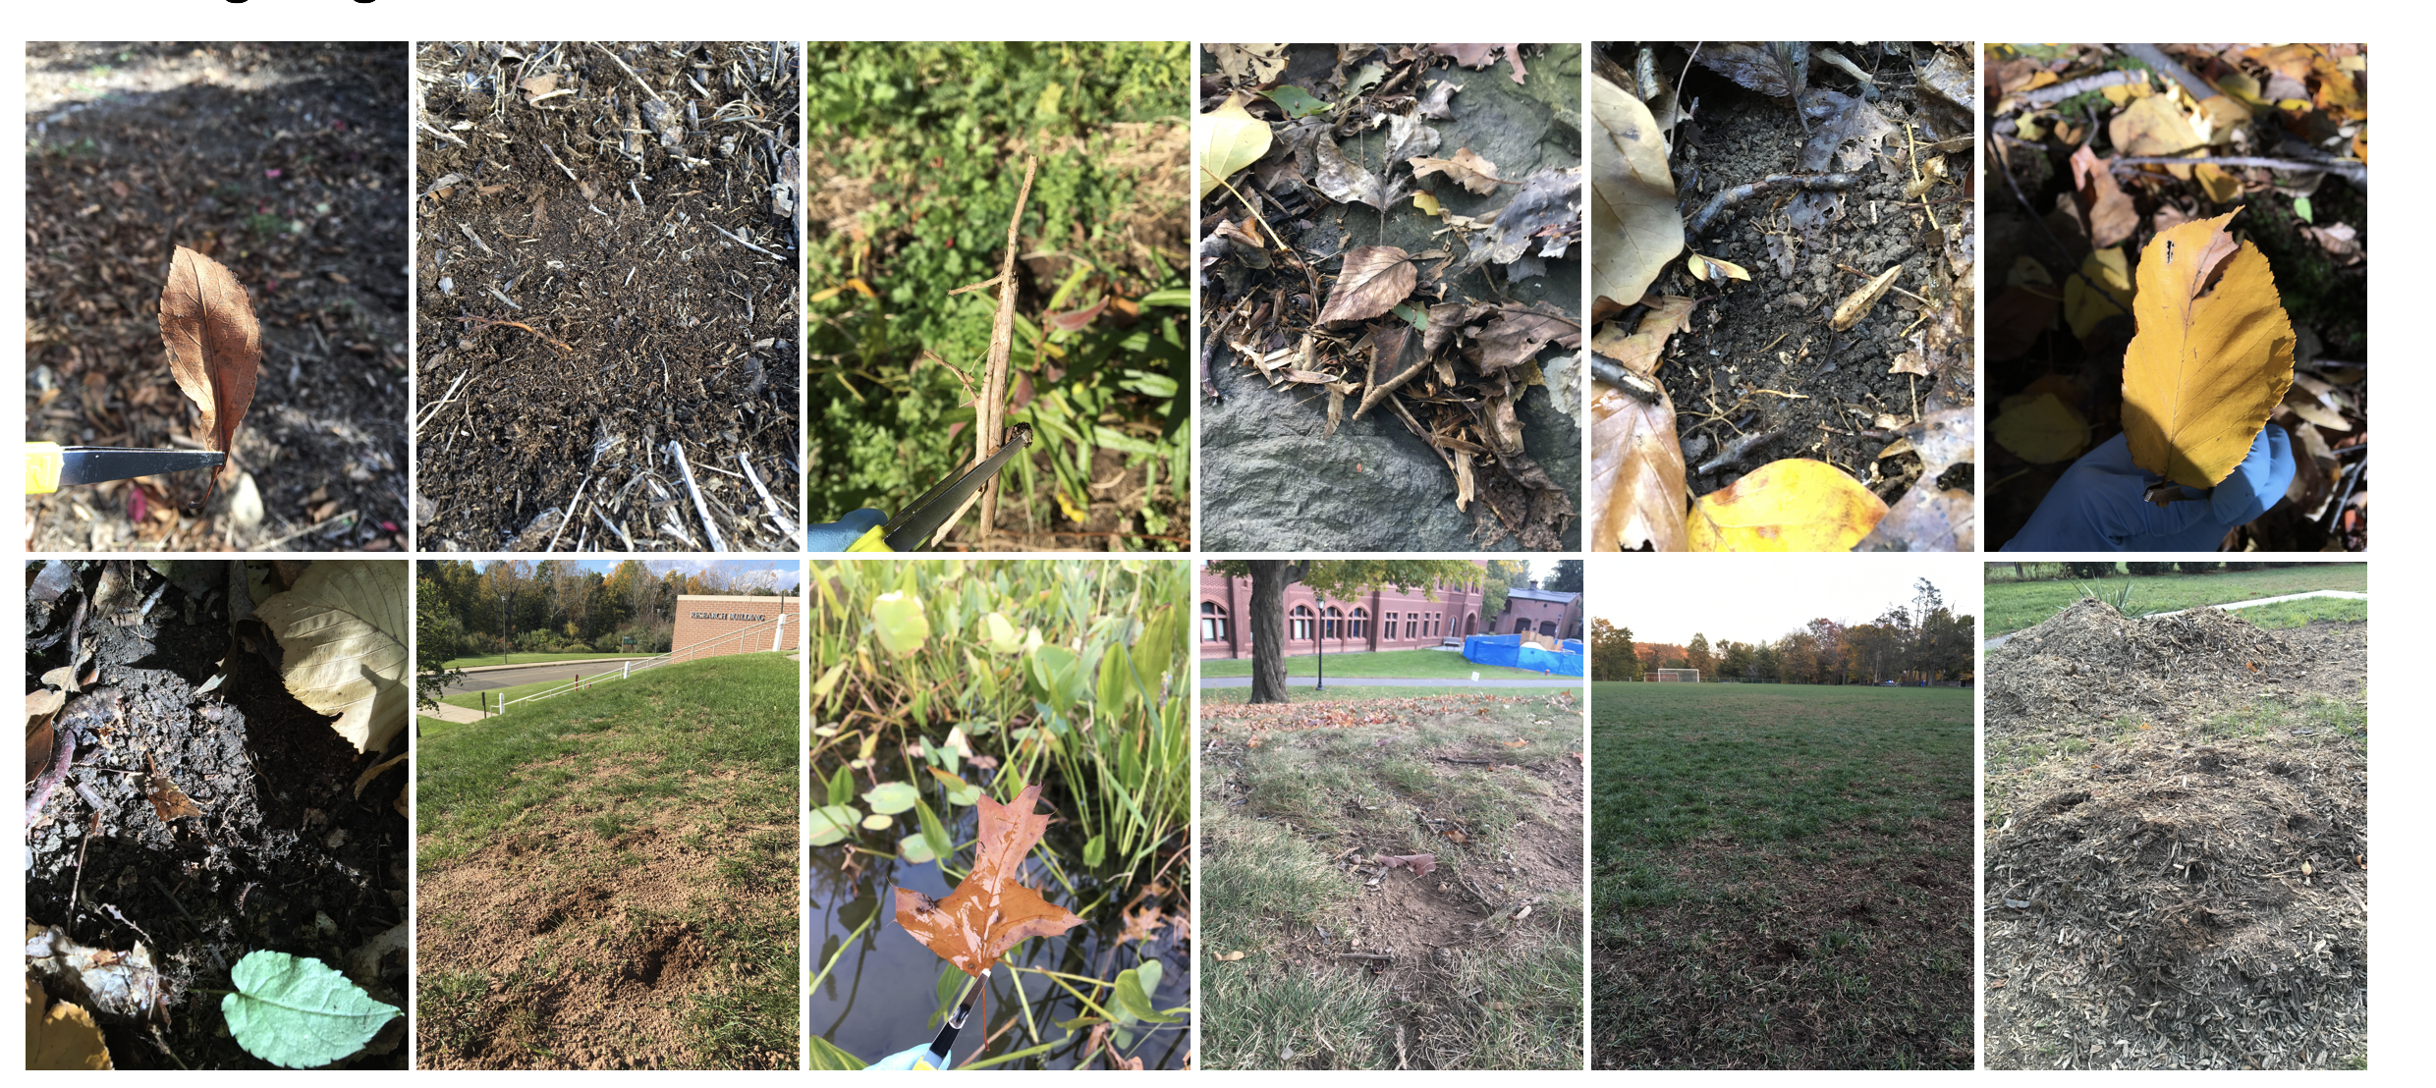
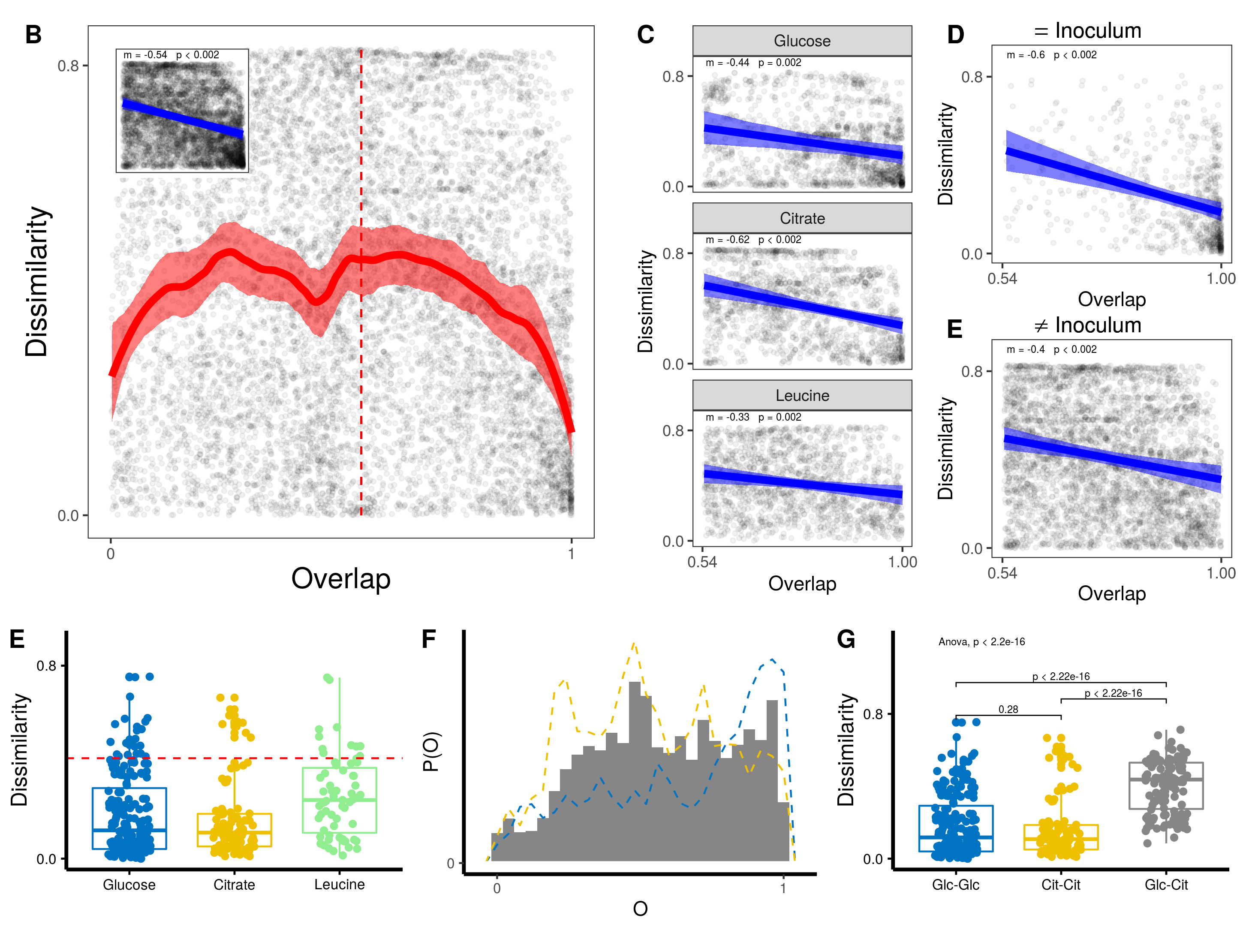
A
growth
bottle-
neck
growth
…
48hr
125x
12 different inocula
3 different nutrient environments
M9+ Glucose, Leucine, Citrate

